Slide 1
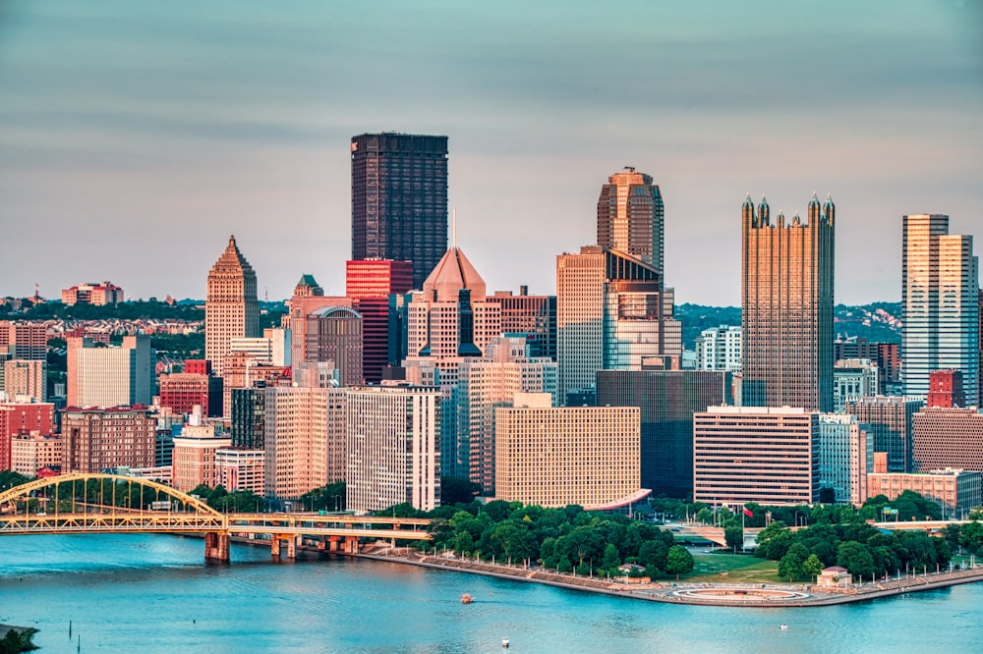
HOUSE & TECHNOLOGY RECOMMENDATIONS
Group 5
Jane Yun, Xiaoli Lin, Nghi Nguyen, Shenrui Guan, Rawan Alsabeh
Notes:
Jane

Slide 2
OBJECTIVES
Recommendation 1: Neighborhood & House for Bauer Family
Amenities (hospital, school, supermarket)
Traffic
Pricing
Investment Potential
Recommendation 2: Technology for Jack Bauer (Field Agent)
Camera
Router
Notes:
Jane Utilize the notes portion (see Notes Page under the View tab of the Power Point slide presentation) of the Power Point Slides for areas that require further explanation. The notes section is used for details of your analysis or work. Use the actual slide for the major points ---do not use full sentences in this area (slide).

Slide 3
OVERALL SUMMARY
Proposal 1: Neighborhood & House
Squirrel Hill (South)
5826 Hobart St, Pittsburgh, PA 15217
Proposal 2: Technology
Canon PowerShot G9X
TP-Link Router
Notes:
Jane

Slide 4
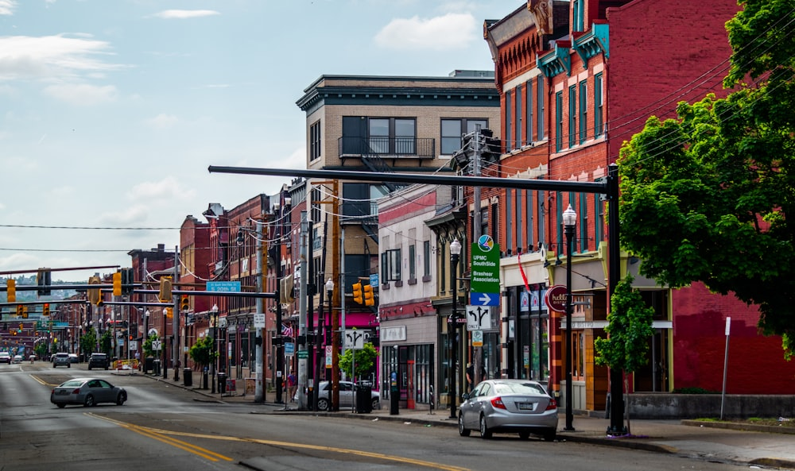
NEIGHBOROOD & HOUSE RECOMMENDATION
Price, Investment Potential, Amenities (hospital, school, supermarket), Traffic
Notes:
Jane

Slide 5
REQUIREMENTS FOR NEIGHBORHOOD
Neighborhood Recommendation
#1 Requirement: Closest to Top 4 Hospitals
#2 Requirement: Number of Top Schools (Grade A)
#3 Requirement: Shortest drive to best Supermarkets
#4 Requirement: Good Traffic
Notes:
Jane

Slide 6
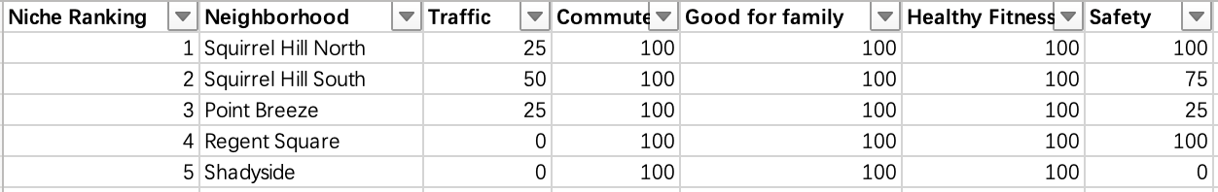
METHOD & MODEL FOR NEIGHBORHOOD
Neighborhood Recommendation
Collect Top 30 neighborhoods in Pittsburgh on niche.com
Grade commute, Good for family, Health & Fitness
Use the 4 requirements
Source: (Western PA Data Center)https://data.wprdc.org/dataset/traffic-count-data-city-of-pittsburgh, (Neighborhood scout)https://www.neighborhoodscout.com/pa/pittsburgh/crime
Notes:
Nghi
Traffic data from Western Pennsylvania Data Center
Safety data from Neighborhood Scout

Slide 7
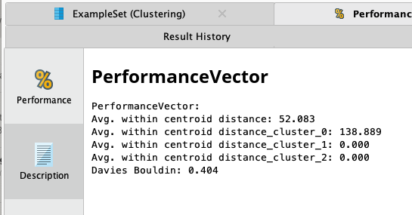
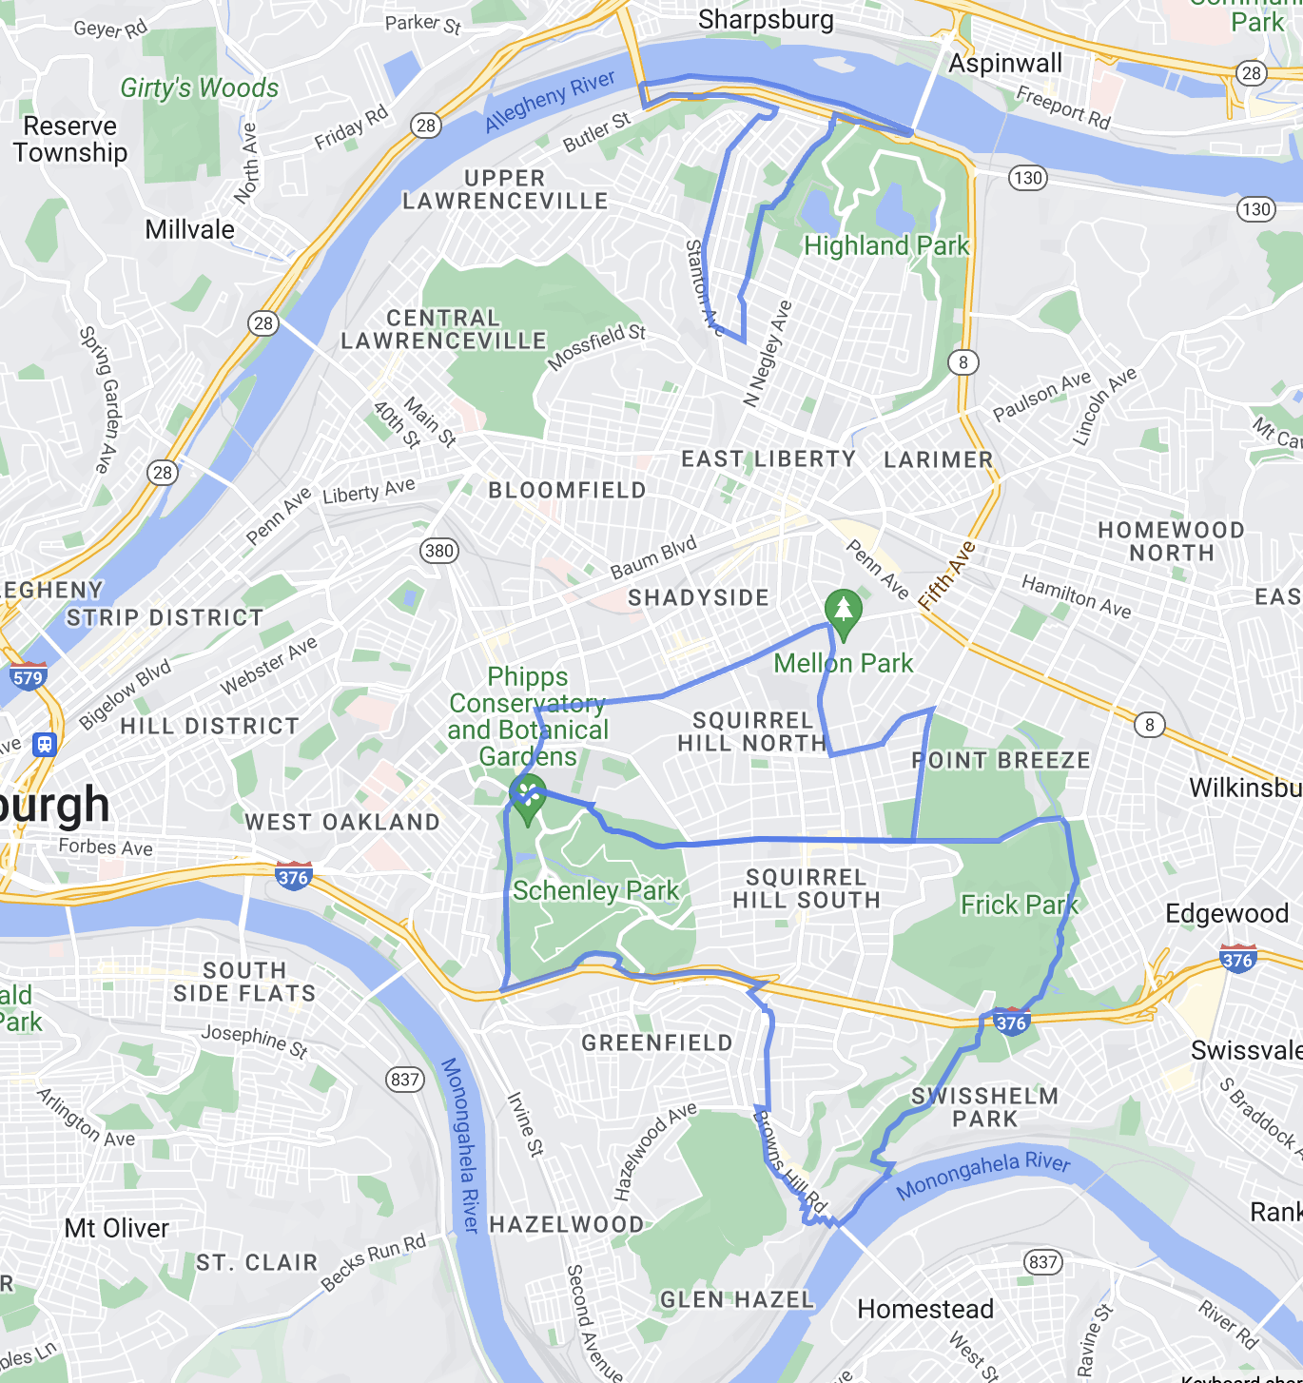
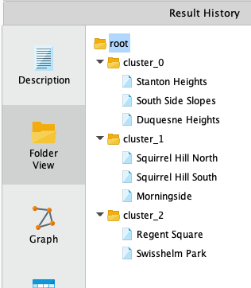
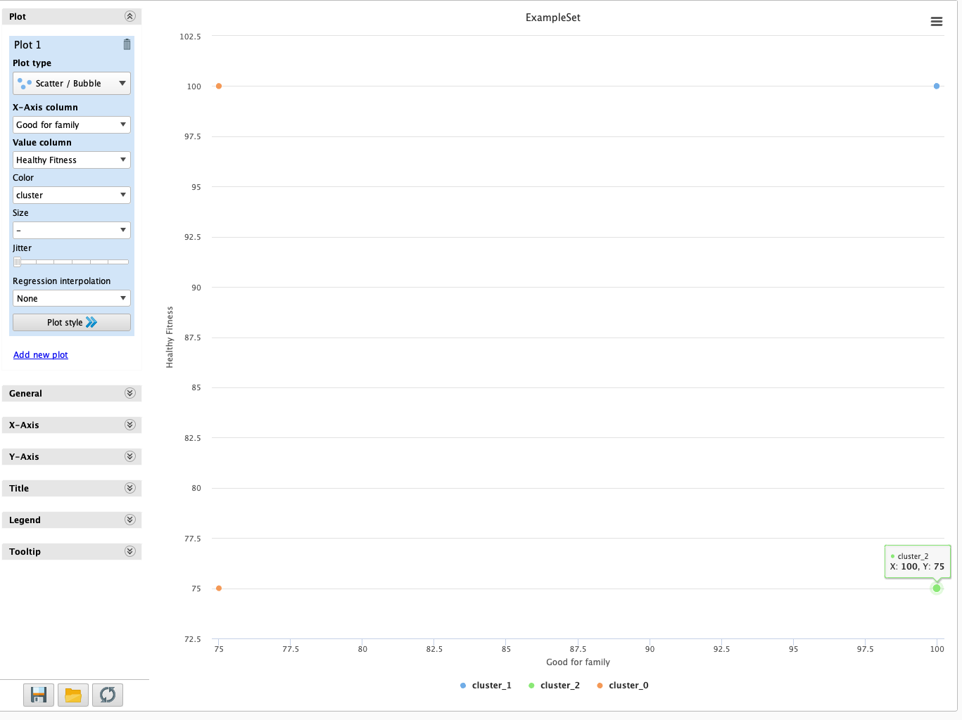
RESULT: THREE NEIGHBORHOOD CANDIDATES
Neighborhood Recommendation
Morning side
Squirrel Hill North
Squirrel Hill South
Source: https://gisgeography.com/pittsburgh-neighborhood-map/
Notes:
Nghi

Slide 8
DISTANCE TO TOP 4 HOSPITALS
Neighborhood Recommendation
Minutes of drive time from Top 4 Hospitals in Pittsburgh
 | UPMC Presbytarian Shadyside | UPMC Passavant | Allegheny General Hospital | Westmoreland Hospital (Independence Health System)
Squirrel Hill North | 5 | 25 | 15 | 39
Squirrel Hill South | 8 | 22 | 12 | 36
Morningside | 10 | 19 | 12 | 42
Source: US News Health
Notes:
Nghi

Slide 9
NUMBER OF GRADE A SCHOOLS
Neighborhood Recommendation
Number of Grade A Schools in each neighborhood
 | Number of Grade A Schools
Squirrel Hill North | 8
Squirrel Hill South | 7
Morningside | 6
Source: niche.com
Notes:
Nghi

Slide 10
DISTANCE TO BEST SUPERMARKETS
Neighborhood Recommendation
Minutes of drive from Top 4 Supermarkets in Pittsburgh
 | Giant Eagle | Wholefoods | Costco | Market District Supermarket
Squirrel Hill North | 3 | 6 | 10 | 4
Squirrel Hill South | 4 | 8 | 7 | 7
Morningside | 11 | 3 | 13 | 9
Source: Google Maps
Notes:
Nghi

Slide 11
NEIGHBORHOOD RESULTS
Neighborhood Recommendation
Squirrel Hill South & Squirrel Hill North were considered as the most appropriate neighborhoods
 | Supermarket | Top 4 Hospital (average driving time) | Number of Grade A School
Squirrel Hill South | 6.5 min | 12 min | 8
Squirrel Hill North | 5.57 min | 15 min | 7
Morningside | 9 min | 12 min | 6
Notes:
Xiaoli

Slide 12
METHOD & MODEL CHOOSING A HOUSE
House Recommendation
Latest data: Search for houses on sale in Squirrel Hill from Zillow
Crawl the info of houses on sale above $500,000
Price, # of beds, # of baths, sqft, Monthly payments (tax, insurance, installment)
Use Excel Forecast.EST to estimate the future value
Calculate the return rate in 5 years
(Future Value – Actual Price) / Actual Price
Pick candidates with top 3 return rate in 5 years
Filter out one house according to 3 rules
Notes:
Xiaoli

Slide 13
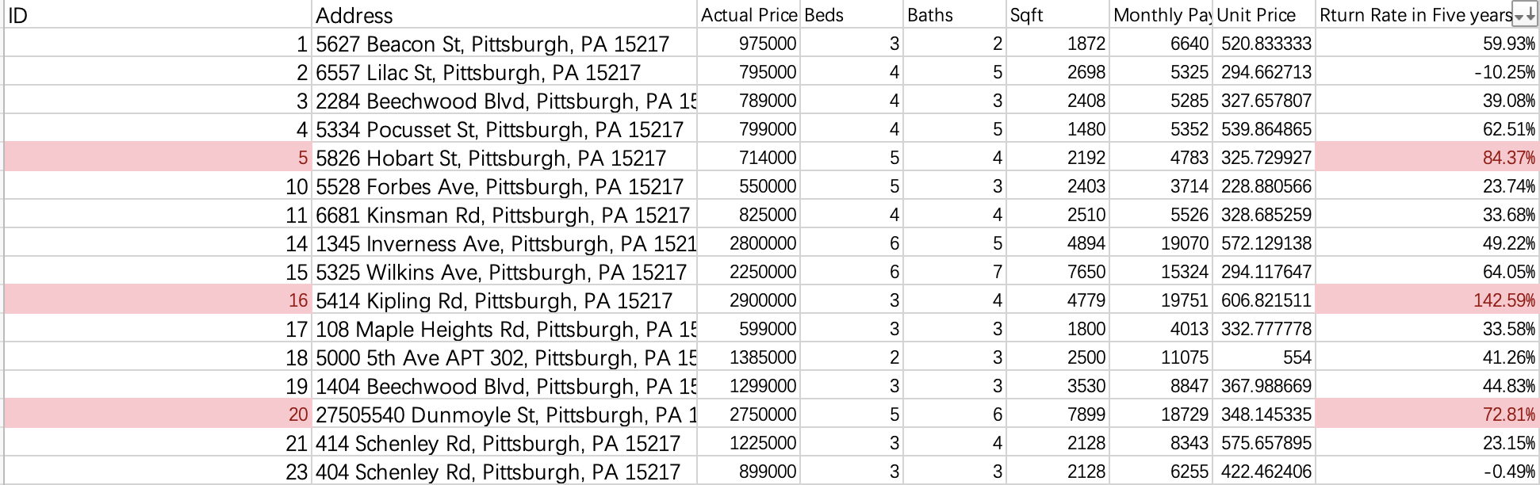
RESULT FOR HOUSE CANDIDATES
House Recommendation
Only invest in houses that has wonderful future value
We find 3 houses with return rate greater than 70%
Notes:
Xiaoli

Slide 14
RESULT FOR HOUSE CANDIDATES
House Recommendation
Rule #1 More beds
Rule #2 Lowest unit price
Rule #3 total price no more than 2 times of $500,000
ID #5 is most appropriate
ID | Address | Actual Price | Beds | Baths | Sq ft | Monthly Payment (principal interest, tax, insurance) | Unit Price | Return Rate (5 years)
5 | 5826 Hobart St, Pittsburgh, PA 15217 | 714000 | 5 | 4 | 2192 | 4783 | 325.73 | 84.37%
16 | 5414 Kipling Rd, Pittsburgh, PA 15217 | 2900000 | 3 | 4 | 4779 | 19751 | 606.82 | 142.59%
20 | 27505540 Dunmoyle St, Pittsburgh, PA 15217 | 2750000 | 5 | 6 | 7899 | 18729 | 348.15 | 72.81%
Notes:
Xiaoli

Slide 15
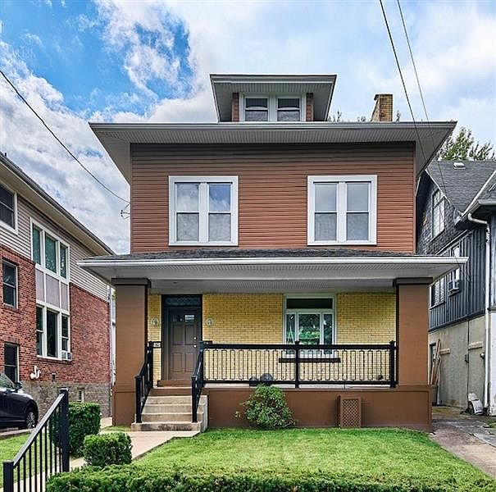
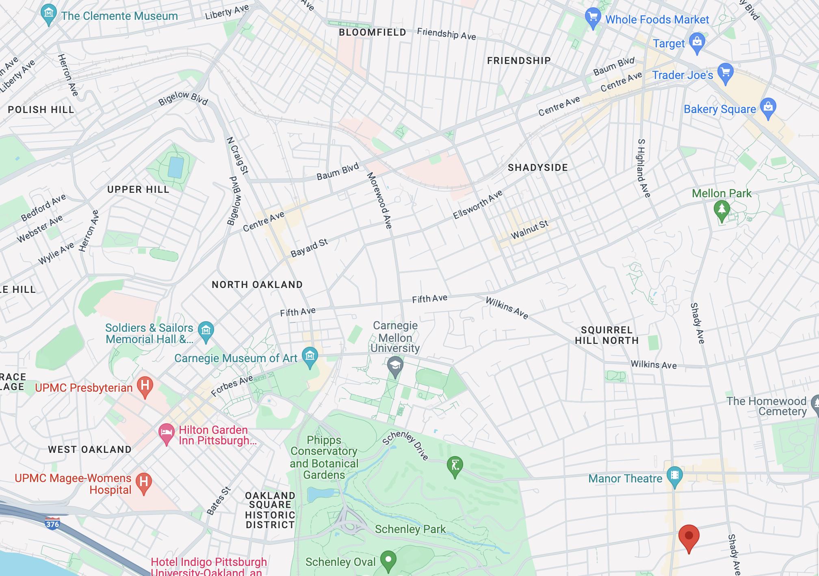
5826 HOBART ST, PITTSBURGH, PA 15217
House Recommendation
5826 Hobart St, Squirrel Hill South, Pittsburgh, PA 15217​
Source: https://www.zillow.com/homedetails/5826-Hobart-St-Pittsburgh-PA-15217/11632029_zpid/
Notes:
Jane

Slide 16
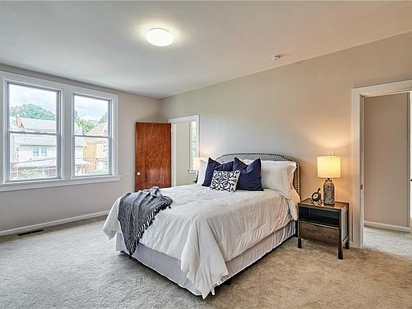
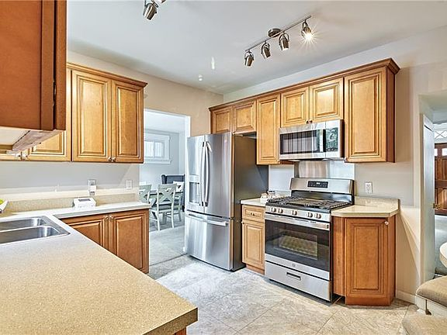
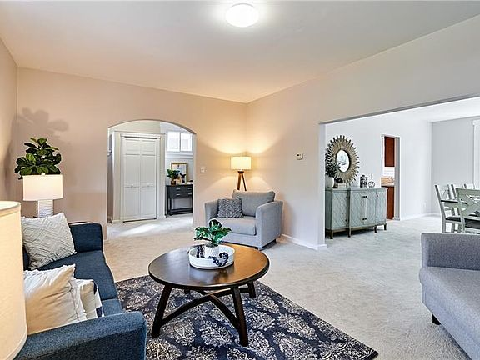
5826 HOBART ST, PITTSBURGH, PA 15217
House Recommendation
Spacious and friendly to families
5 bedrooms and 4 Bath​
2192 sqft
Reasonable price in top neighborhood
$714,000 total price​
Unit price $32,573/sqft
$4,783 monthly pay
Source: https://www.zillow.com/homedetails/5826-Hobart-St-Pittsburgh-PA-15217/11632029_zpid/
Notes:
Jane

Slide 17
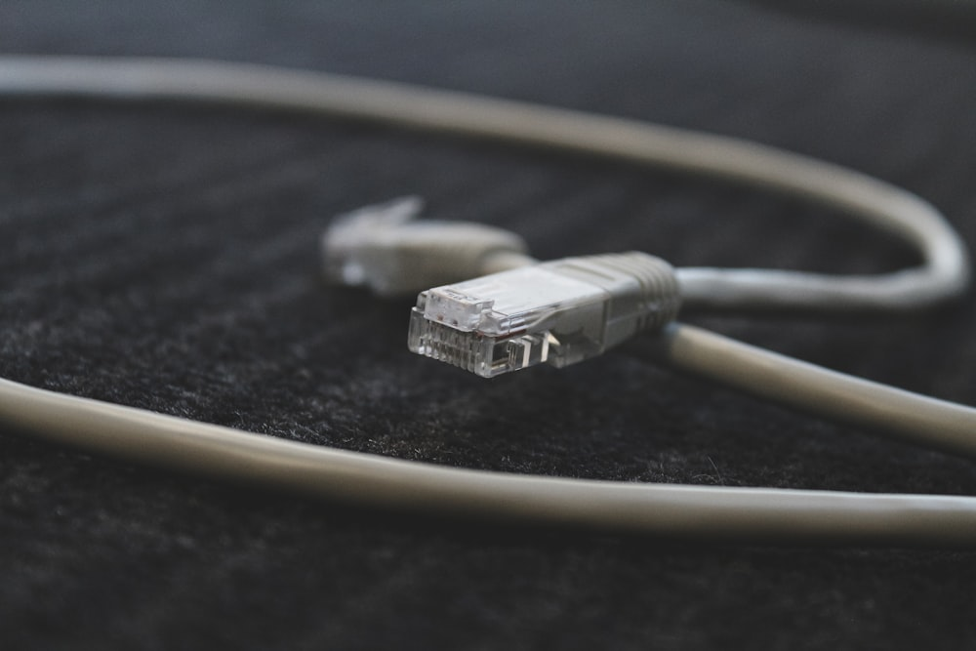
TECHNOLOGY RECOMMENDATION
Camera & Router

Slide 18
METHOD & MODEL FOR CAMERA & ROUTER
Camera Recommendation
Perform Sentiment Analyst with data provide by professor.
All came back positive but models are outdated and discontinued.

Slide 19
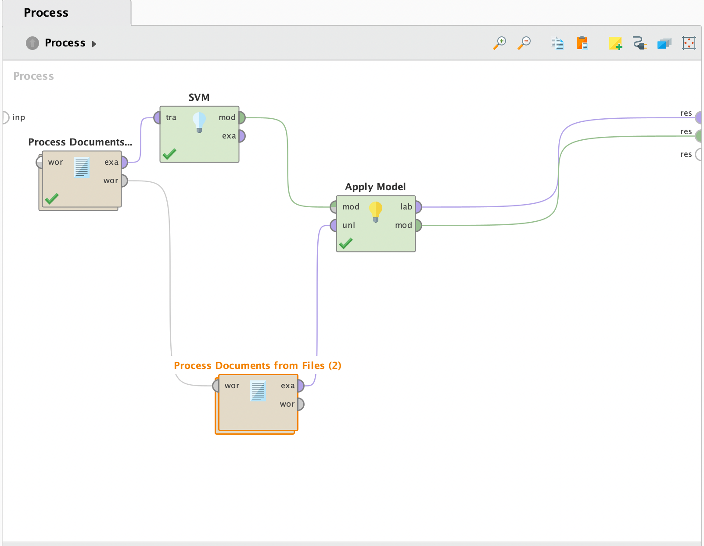
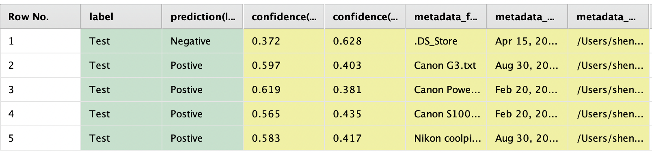
RESULT FOR CAMERA
Camera Recommendation
All came back positive after preform the sentiment Analyst

Slide 20
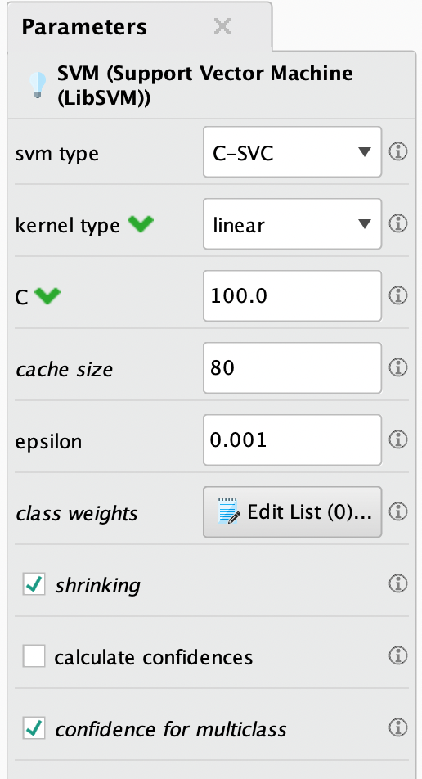
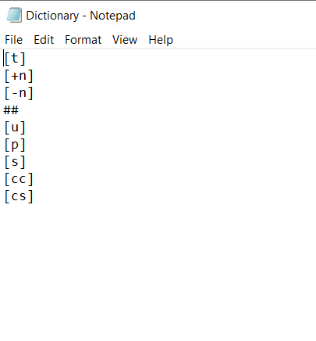
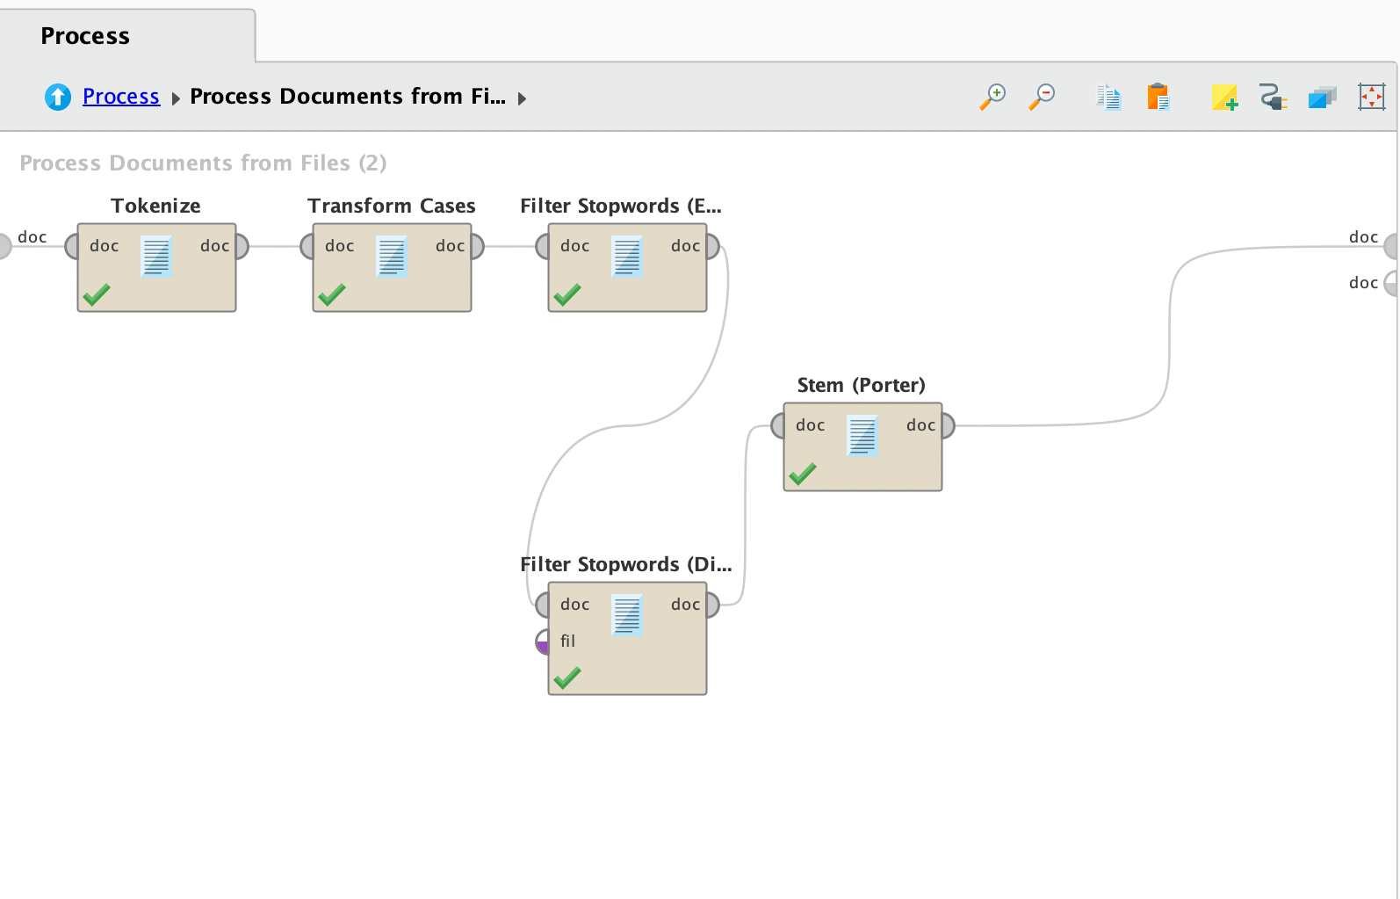
SENTIMENT SETTING
Camera Recommendation

Slide 21
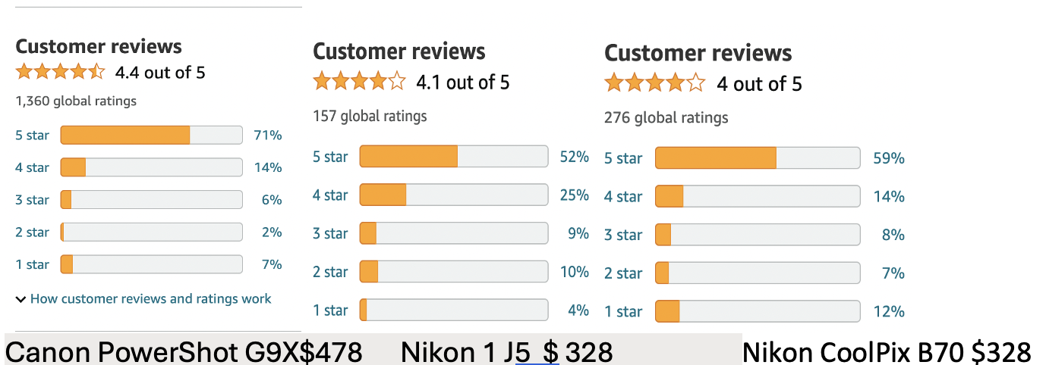
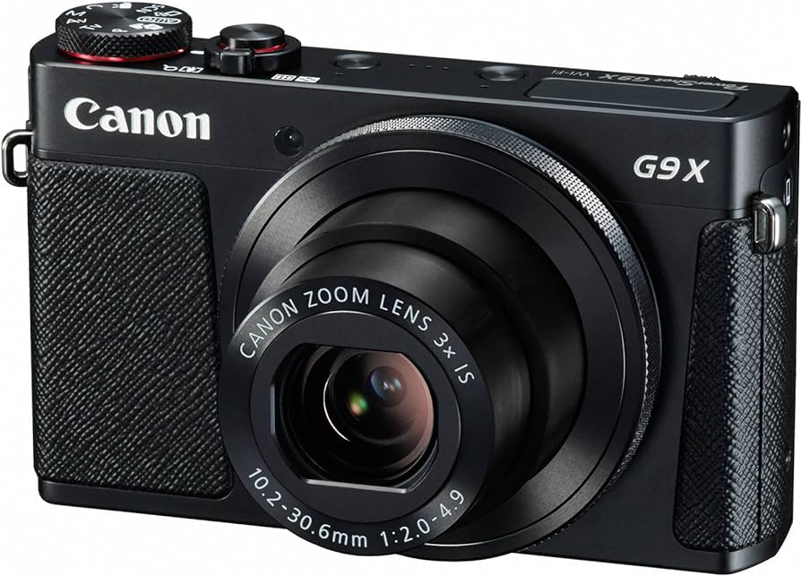
INTERPRETATION FOR CAMERA
Camera Recommendation
Canon PowerShot G9X: Image quality, Quality Compactness, Ease of use, Low light capability
Nikon 1 J5: Picture quality, SizeEase of use, Speed Appearance Lens Portability
Nikon CoolPix B70: Quality Picture, ZoomEase of use, Weight, Autofocus, Battery life

Slide 22
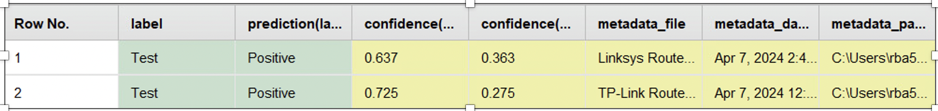
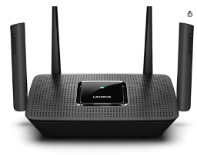
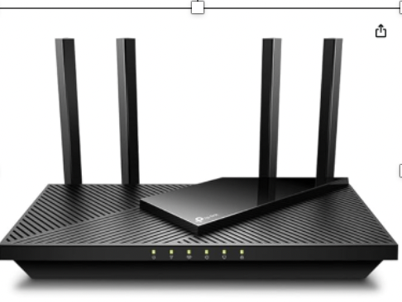
RESULTS FOR ROUTERS
Router Recommendation
Both are positive, requiring more ratings
Linksys Router MR8300 $108
TP-Link Router AX1800 $69.70

Slide 23
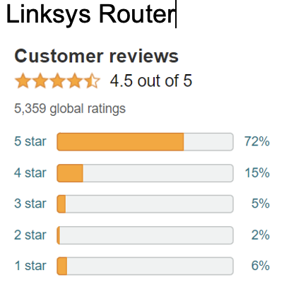
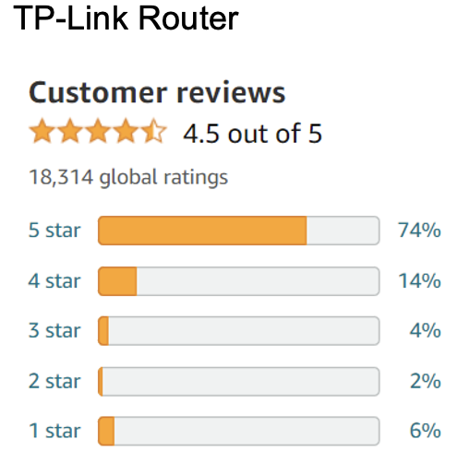
INTERPRETATION FOR ROUTER
Router Recommendation
TP-Link Router 74% 5 stars
Linksys Router 72% 5 stars
TP-Link Router has lower price
TP-Link Router is recommended

Slide 24
SOURCES
Amazon Customer Reviews for Camera & Router
Niche Pittsburgh: https://www.niche.com/places-to-live/pittsburgh-allegheny-pa/
Pittsburgh Crime rate: https://www.neighborhoodscout.com/pa/pittsburgh/crime
Pittsburgh Photos: https://unsplash.com/s/photos/pittsburgh
Pittsburgh Zillow: https://www.zillow.com/homes/for_sale/Pittsburgh,-PA_rb/
Ranking Pittsburgh Neighborhood: https://www.niche.com/places-to-live/search/best-neighborhoods/t/pittsburgh-allegheny-pa/
Traffic count data: https://data.wprdc.org/dataset/traffic-count-data-city-of-pittsburgh

